Slide 1

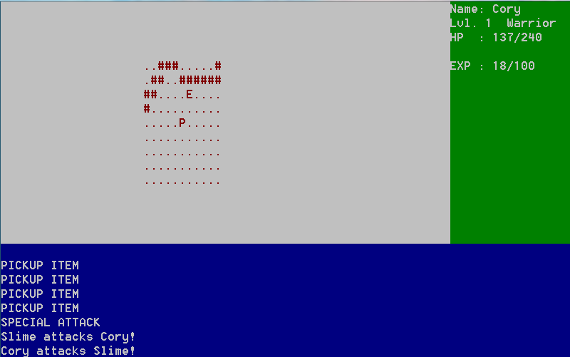
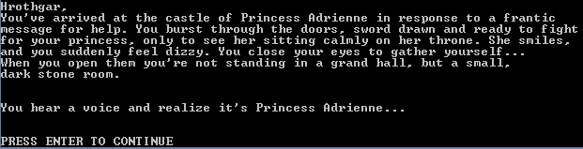
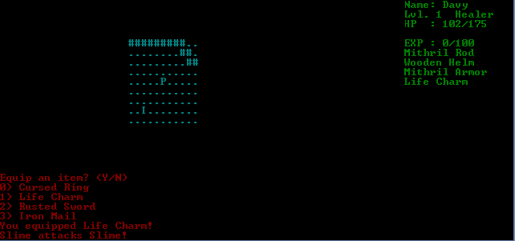
The Fall of Chivalry
Jonathan Collins, Orville Bailey, Jacob Daniel
Concord University, Department of Math, Athens WV 24712
Abstract
Showcasing Windows
The Story
We learned how to setup and install the PDCurses library, allowing us to manipulate portions of our screen to create a roguelike game, such as NetHack. Roguelikes often appear as simple as your car; just hop in and drive. Like your car, they also have an engine under the hood and require engineers and mechanics to create and maintain the project. These programs provide a solid setting for design work and teamwork skills to be polished.
Early Development
Introduction
Our project was to create a game of the roguelike genre. The main features that make a roguelike game are the difficulty and permanent death. We made both of these features and included a rock puzzle where the objective is to match the boulders to the switches. This project was our first experience with a large project that needed to be worked by different people in different areas.
In early development, we used generic messages to represent button presses.
Goals
Submission
We aimed to create a simpler version of one of the many iconic RogueLike games that are loved by few but played by many. While doing this our major goal was to have a presentable product by the time of the due date.
Results
Acknowledgments
Through the process of game engine development we realized as a team that there is no way that everyone can work on the same aspect of a project and expect to finish in time. This lead to the realization of why it is necessary to document why a piece of code was written and what it does.
PDCurses – Development Library
GitHub – Development Control Tool
CodeBlocks – Coding Software
Google – Infinite Knowledge
Profesor Lonnie Bowe – Awesome Instructor
Britt Strother - Storyline
Matt Rawson - Title
The submission version offers more polish and functionality than our original design.
Do Not Write Below this Line

